Slide 1
Case 5: Joshua, Sara, Shouyang, Shaolun, Yongqin, Riina
Case 5
Canadian Occidental Petroleum Ltd.
Wascana Energy Inc.

Slide 2
Problem and Decision Statement
Background Information
Quantitative Analysis
Qualitative Considerations
Issues To Address

Slide 3
What is a fair per share acquisition price?
Acquirer
Canadian Occidental Petroleum Ltd.
Acquiree
Wascana Energy Inc.
Conclusions
Issue At Hand
Problem and Decision Statement

Slide 4
Wascana Energy Inc.
Pre-Takeover
$13.95
Post-Takeover
$17.28
Talisman’s Bid
$18.50
Valuation Methods:
Comparables Method
Discounted Cash Flow
Considerations:
Value Drivers
Risk Management
Uncertain Resources
Conclusions
Problem and Decision Statement

Slide 5
Background Information
QA

Slide 6
Synergies
Growth
Value Bid
Target: Wascana Energy
Acquirer: Canadian Occidental
Value Drivers: Oil and Gas Companies
Benefits of Acquisitions
Background Information

Slide 7
2P (Proven + Possible) Reserves
Commodity Quality
Field Netback
Extraction Technology
Reserve replacement
Value
Anchors
Efficiencies
Target: Wascana Energy
Acquirer: Canadian Occidental
Value Drivers: Oil and Gas Companies
Background Information
Horizon

Slide 8

Canadian Occidental Petroleum Ltd.
Global Energy and Chemicals
Production per Day
137,600 Barrels
244 Million Cubic Feet Gas
162,000 Barrels of Oil Equivalent in Total
Reserves
518 mm bbl.
824 bcf.
Undeveloped “Risked” Land
8.6 Million Acres
Target: Wascana Energy
Acquirer: Canadian Occidental
Background Information

Slide 9
Wascana Energy Inc.
North American Oil and Gas
Saskatchewan Based
Production per Day
51,400 Barrels
200 Million Cubic Feet Gas
71,400 Barrels of Oil Equivalent in Total
Reserves
71 Million Barrels of Oil Equivalent in Total
Undeveloped “Risked” Land
2.5 Million Acres
Target: Wascana Energy
Background Information

Slide 10
Quantitative Analysis
QA

Slide 11
Inputs (Derived or Hardcoded)
Wascana |  |  | Price/ Trailing CFPS | Price/ Forward CFPS | Debt BV/ Forward CFPS | Asset BV/ BOE/D of Production | Asset BV/ BOE of Reserves
1996 CFPS |  | 2.55
1997 CFPS |  | 2.98
Total BV of Debt Mulitiple |  | 2.68
BOE/D |  | 71,400
BOE reserves |  | 589,240,000
Share Count |  | 67,010,309
Comparables Valuations |  |  | (p/share) | (p/share) | (Debt BV) | (Asset BV) | (Asset BV)
Crestar |  |  | 14.02 | 15.80 | 233,726,901 | 1,864,539,600 | 4,996,755,200
ELAN |  |  | 13.00 | 14.61 | 125,852,947 | 1,735,305,600 | 3,629,718,400
Poco |  |  | 18.86 | 18.48 | 215,747,909 | 2,545,124,400 | 6,145,773,200
Ranger |  |  | 20.39 | 22.06 | 89,894,962 | 2,356,200,000 | 5,886,507,600
Rigel |  |  | 15.80 | 17.29 | 233,726,901 | 2,038,755,600 | 4,348,591,200
Stampeder |  |  | 17.58 | 16.69 | 215,747,909 | 1,835,622,600 | 4,124,680,000
Tarragon |  |  | 17.84 | 17.29 | 233,726,901 | 2,685,496,800 | 4,625,534,000
AVERAGE |  |  | 16.82 | 17.59 | 197,768,917 | 2,151,567,600 | 4,819,983,200
Discounted Cash Flow – Results
Discounted Cash Flow – Cost of Capital Assumptions
Discounted Cash Flow – Operation Assumptions
Discounted Cash Flow – Overview
Relative Valuation
Quantitative Analysis

Slide 12
Barrels of Oil Equivalent Production
Decompose
Production Costs and Requirements
Income Growth
&
Production Forecast
Income Statement
&
Capital Structure
Free Cash Flow
&
Valuation
Discounted Cash Flow – Results
Discounted Cash Flow – Cost of Capital Assumptions
Discounted Cash Flow – Operation Assumptions
Discounted Cash Flow – Overview
Quantitative Analysis

Slide 13
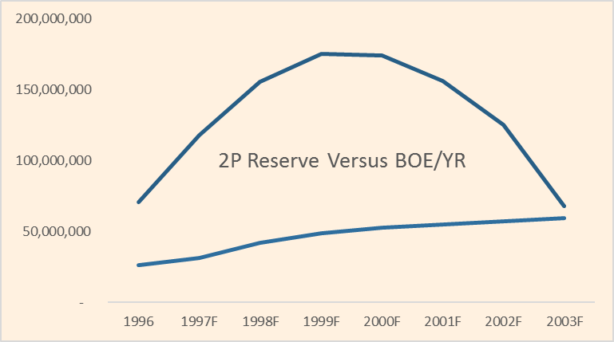
Discounted Cash Flow – Results
Discounted Cash Flow – Cost of Capital Assumptions
Discounted Cash Flow – Operation Assumptions
Quantitative Analysis

Slide 14
Wascana Inc. After Merger
Discounted Cash Flow – Results
Discounted Cash Flow – Cost of Capital Assumptions
Quantitative Analysis

Slide 15
Wascana Inc. After Merger
Canadian Occidental
Discounted Cash Flow – Results
Quantitative Analysis
See Appendices for FCF Calculation

Slide 16
Qualitative Considerations
QA

Slide 17
Historical Risk Factors
Commodity price volatility
FX change risk
Interest rate risk
Geopolitics
Diversification
Undeveloped Reserves
Wascana Risk Mitigation
Historical Risk Factors
Qualitative Considerations

Slide 18


Wascana Risk Management
Price risk hedge: futures contracts
Cons| Basis Risk Truncation of upside Liquidity Pressure
FX change risk hedge: Currency derivatives
Wascana
Inc
Swap Counterparty
Pays CDN$ Interest
Diversification
Undeveloped Reserves
Wascana Risk Mitigation
Qualitative Considerations
Receives US$ Interest

Slide 19
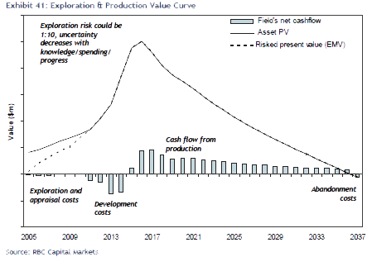
Diversification
Undeveloped Reserves
Qualitative Considerations
Risked Undeveloped Land
Price per Acre: $50.00-$75.00

Slide 20
Canadian Occidental Petroleum Ltd.
Canada (Overall) | United States | Yemen
Wascana Energy Inc.
Saskatchewan | Venezuela | Algeria | Northern United States
The Combined Firm
Canada | Venezuela | Algeria | United States | Yemen
Diversification
Qualitative Considerations

Slide 21
Recap: Problem and Decision

Slide 22
Questions and Answers
Problem and Decision Statement
Selected Canadian Economic Data
Background Information
Actual and Projected Commodity Prices
Quantitative Analysis
Comparables Universe
Qualitative Considerations
Wascana Post Merger FCF Calculation

Slide 23
QA

Slide 24
QA

Slide 25
QA

Slide 26
QA

